Slide 1

40th Annual Meeting
"Clinical Trials: A Catalyst for Societal Advancement through Innovation"
ANNUAL BUSINESS MEETING
2019
Sheraton New Orleans
New Orleans, Louisiana USA
Tuesday, May 21, 2019
Napoleon BC

Slide 2
2018 Business Meeting Agenda
40th Annual Meeting – “Clinical Trials: A Catalyst for Societal Advancement through Innovation”
President’s Welcome and Report
Clinical Trials Journal Report
Membership Committee Update
Communications Committee Update
Chalmers Student Scholarship
Sylvan Green Winner
Best Poster Presentation
Remarks from Incoming President
Outgoing Remarks

Slide 3
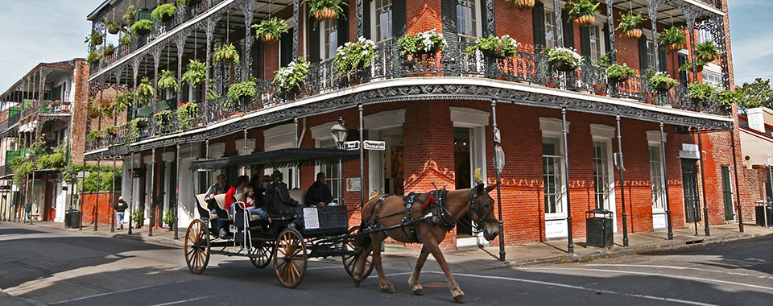
President’s Report
Sumithra Mandrekar

Slide 4
2018 Business Meeting Minutes
President’s Report (Ted Karrison)
Webinar Series
Finalization of Manuals of Procedures
Updating of Other Key Society Documents
Drafting of a Strategic Plan
Vibrant Newsletter
Changes to the Constitution and Bylaws
Journal Report (Colin Begg)
Treasurer’s Report (Joe Collins)
Student Scholarship Report (Jim Dignam)
Incoming President Remarks (Sumithra Mandrekar)
Adjourn
Motion to Approve 2018 Minutes

Slide 5
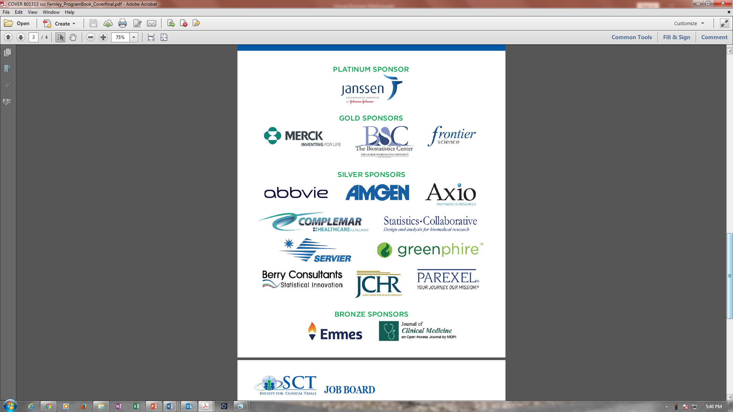
2019 Corporate Sponsors

Slide 6
2019 Corporate Sponsors

Slide 7
In Recognition of Individual Donors
May 1, 2018 – April 30, 2019
GENERAL FUND CONTRIBUTORS
CURTIS MEINERT
KEYNOTE HONORARY ADDRESS DONATION
Kevin Buhr
Janet Darbyshire
Dennis O. Dixon
Lynda Marie Emel
Susan Groshen
Virginia Howard
Theodore Karrison
Peter G. Kaufmann
Anne S. Lindblad
Michele Melia
Philip C. Prorock
Anne Ryan
Steven Snappin
Cathie Spino
Nancy Stambler
Martin R. Stockler
Milagros Tan-Pineda
Michael Terrin
Patty Winger
Kevin Buhr
Barbara S. Hawkins
Amy Ruppert Stark
Martin R. Stockler
Donald Taves
O. Dale Williams

Slide 8
In Recognition of Individual Donors
May 1, 2018 – April 30, 2019
SYLVAN GREEN
SCHOLARSHIP PROGRAM DONATION
THOMAS CHALMERS STUDENT SCHOLARSHIP AWARD FUND
Kevin Buhr
James J. Dignam
Jonas Ellenberg
Jay Herson
Anne S. Lindblad
Robert Lindblad
Carol K. Redmond
Yves D. Rosenberg
Martin R. Stockler
Michael Terrin
Jesse A. Berlin
Stephen A. Bernard
Kevin Buhr
James J. Dignam
Lynda Marie Emel
Donna Levy
Robert Lindblad
Frank W. Rockhold
Cathie Spino
Martin R. Stockler
Elizabeth L. Turner
Elizabeth C. Wright

Slide 9
The 1985 New Orleans Meeting!
The first time the Society held a meeting in New Orleans was May 12-15, 1985. It was the Sixth Annual Meeting and was held at the Hyatt Regency.
President: Thomas Chalmers, one of the Founders of the Society.
Plenary Lectures:
Post-Randomization Informed Consent
Who Should Have Access to Data from Clinical Trials?

Slide 10
2018-2019 Year in Review (Highlights)
Planning Committee (Summer of 2018)
Tisha, Lynda, Wendy, Scott, Valerie, Li, Sumithra, Fernley Staff
Theme for the 40th meeting, and selected topics for invited sessions and workshops
Implementation of the 3-Year SCT Strategic Plan
Pursue Diversity in Membership
Nurturing Society Leadership
Formation of the Leadership Committee
Chairs: Valerie and Mithat

Slide 11
2019 Webinar Series
Free to Members
Sponsored by SCT Education Committee
Register Online at www.sctweb.org – Members Only Section
October 17 or 24, 2019 – 11 am ET
Presenter: Ram Tiwari, Chenguang Wang
Topic: Innovative Statistical Approaches for Utilization of External Evidence in Clinical Trials: Challenges and Opportunities
April 23, 2019 – 11 am ET
Presenter: David Kerr
Topic: Data Monitoring Committees
July 2019 – TBD
Presenter: Martin Offringa, Nancy Butcher
Topic: New Standard for Outcome Reporting in Clinical Trials: Instru-ment for Reporting Planned End-points in Clinical Trials InsPECT 2019
December 2019 – TBD
Presenter: Vlad Dragalin
Topic: Understanding the Estimand Framework

Slide 12
SCT Speaker Agreement
Recommended after some copyright infringement issues that were brought to SCT’s attention in early 2019 about presentation material posted on our website after the meeting.
In conjunction with SCT’s Annual Meeting, our legal counsel developed the consent form that was circulated to all presenters to sign for the 2019 meeting.
For the 2020 meeting, the plan is for prospective presenters to sign this form at the time of abstract submission.
Thank you all for your feedback on the form; we will work with you to develop a consent form that is agreeable.

Slide 13
Financial Report

Slide 14
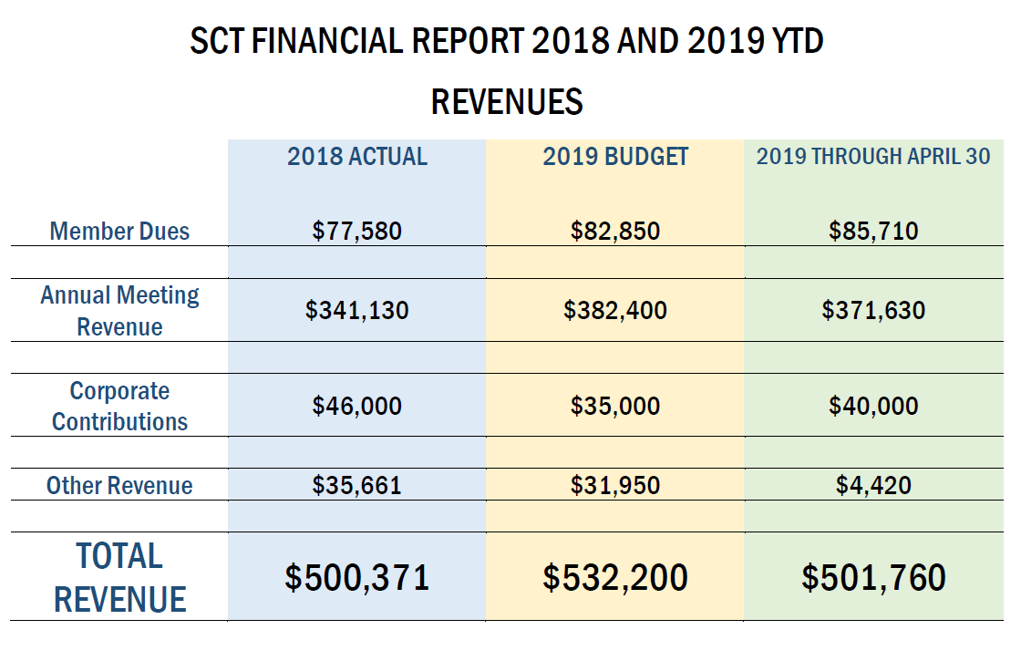

Slide 15
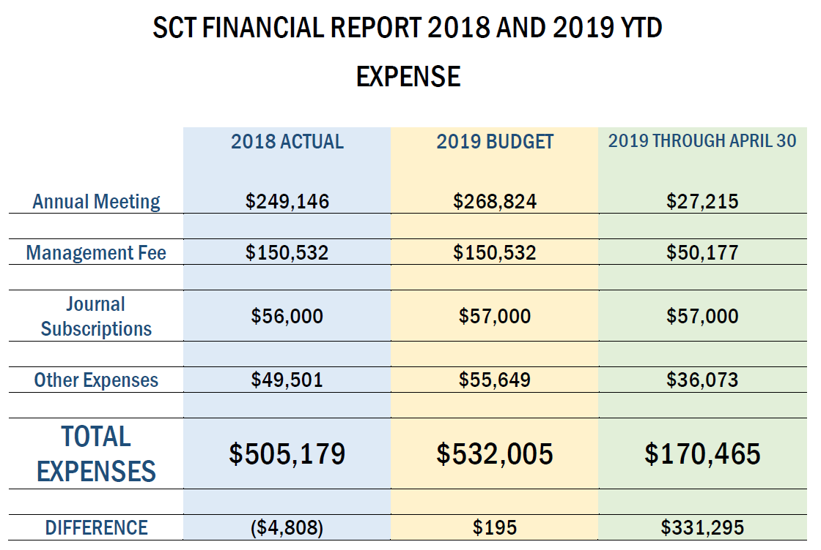

Slide 16
Your SCT Leaders

Slide 17
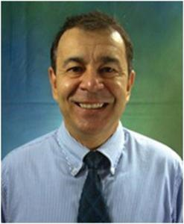
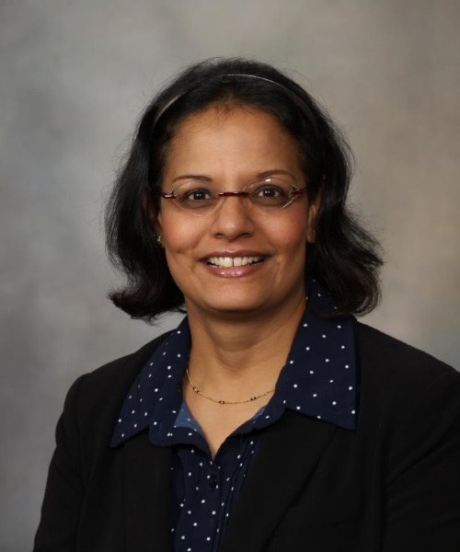
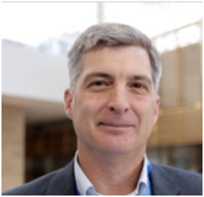
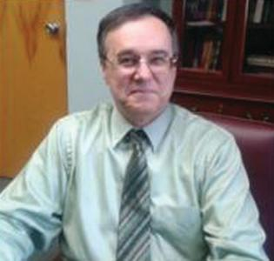
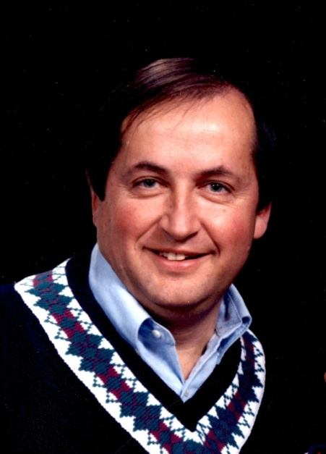
2018-2019 Executive Committee
Ted Karrison
Past President
Dean Fergusson
President Elect
Sumithra Mandrekar
President
Domenic Reda Secretary
Joseph F. Collins Treasurer

Slide 18
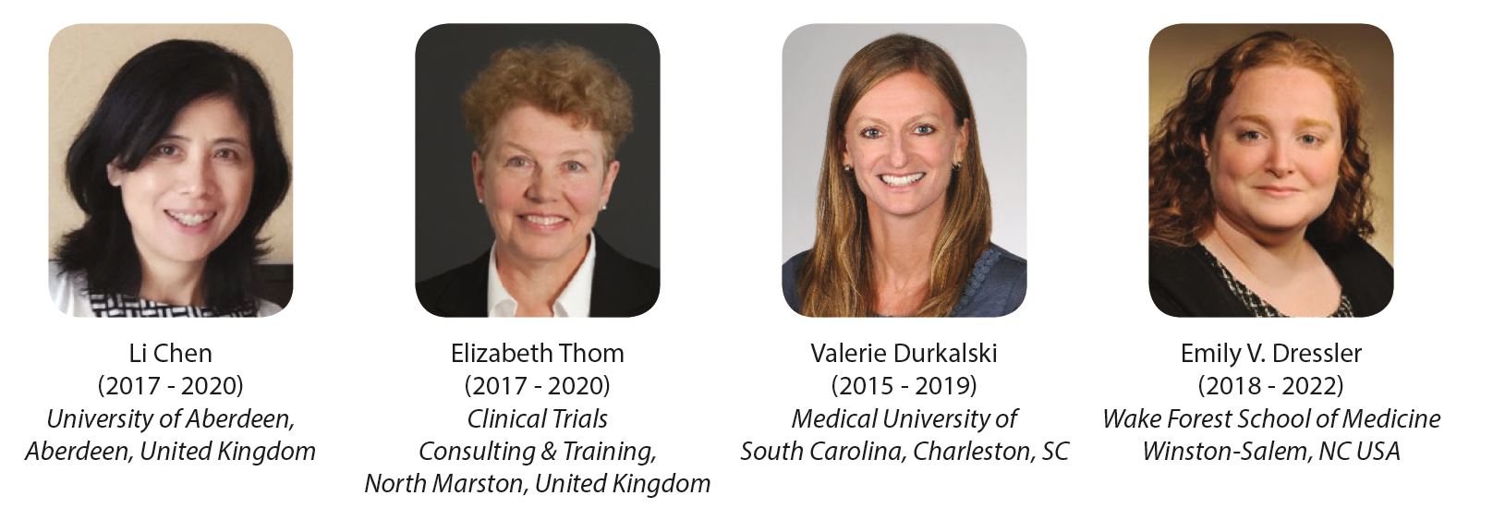
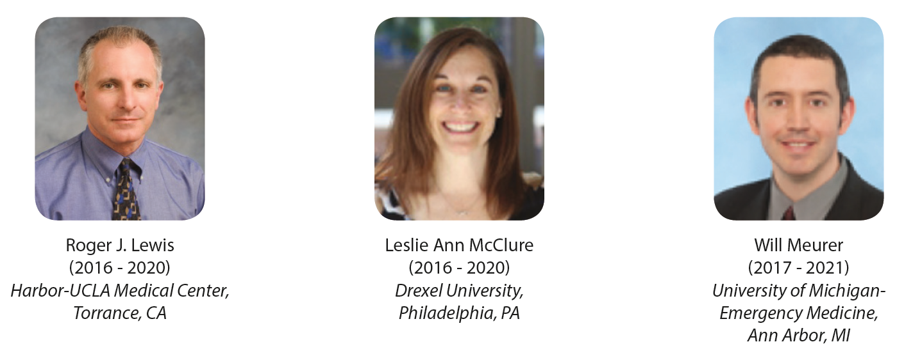
2018-2019 Board of Directors

Slide 19
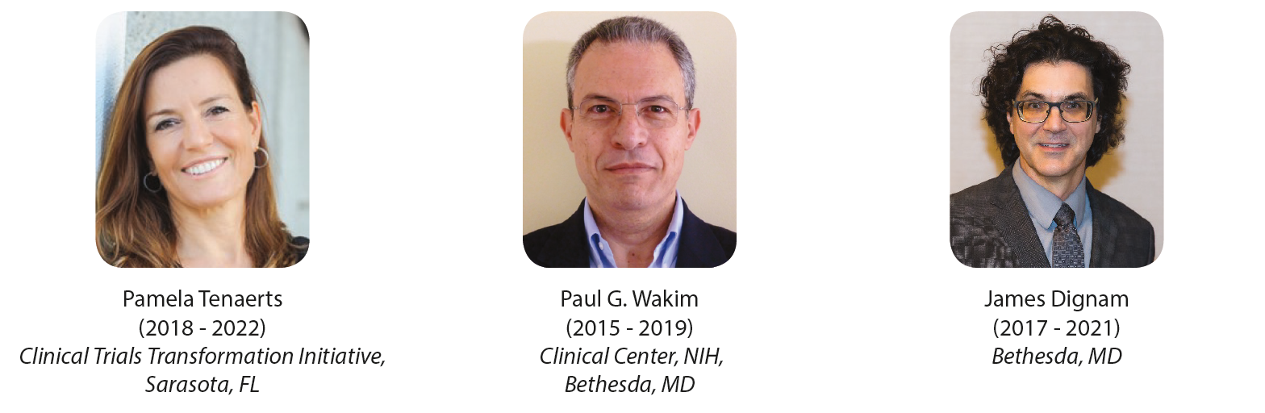
2018-2019 Board of Directors
(continued)

Slide 20
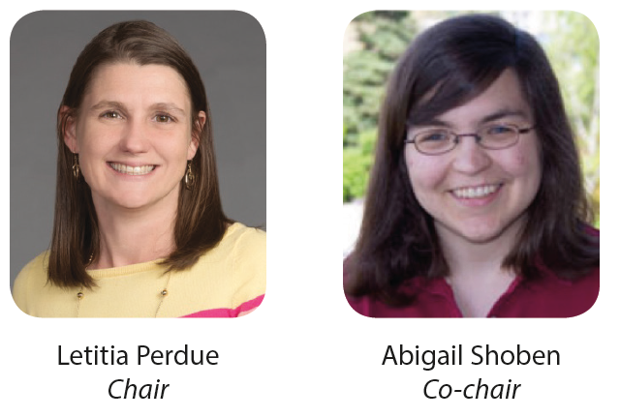
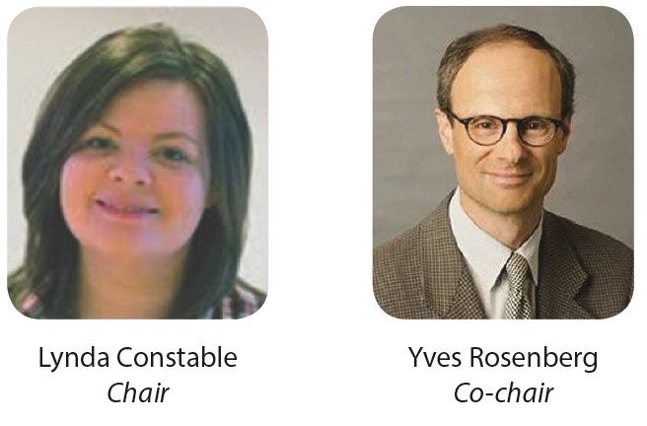
2019 Program Chairs
2019 Education Committee Chairs

Slide 21
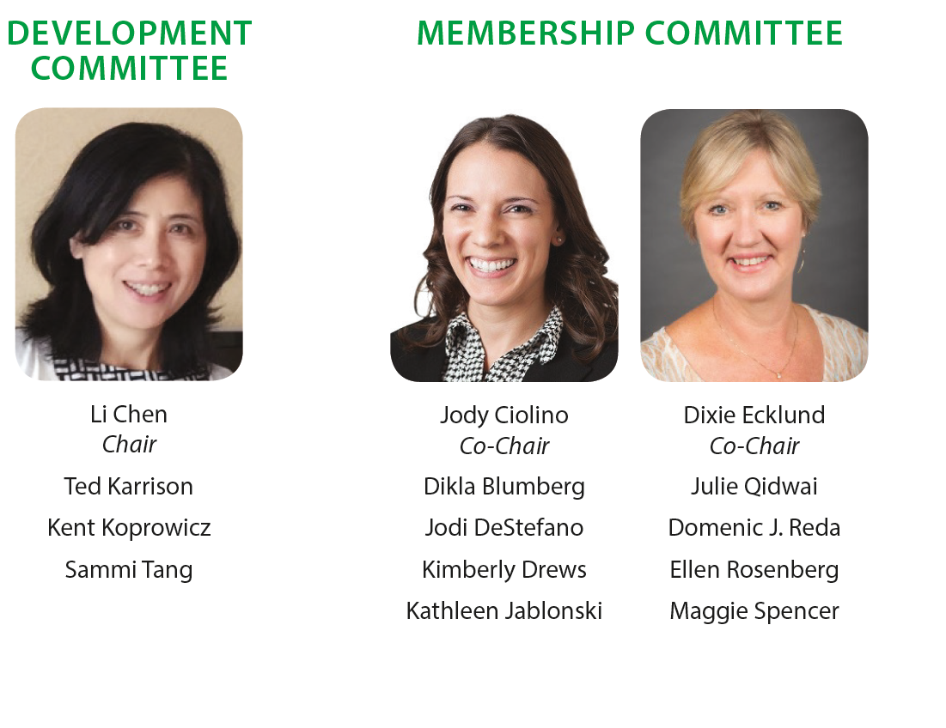
2019 SCT Committee Chairs
(continued)

Slide 22
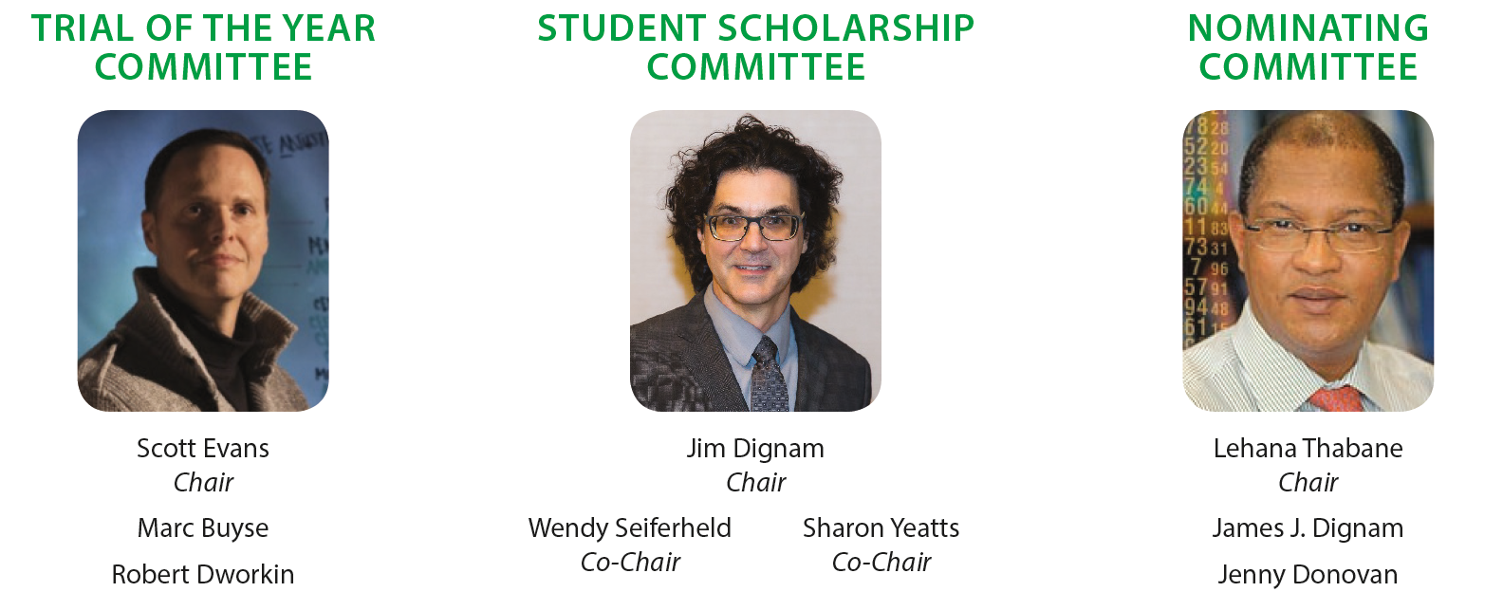
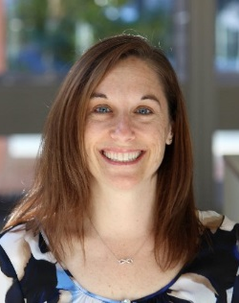
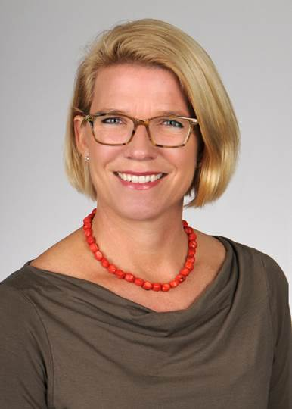
2019 SCT Committee Chairs
(continued)
COMMUNICATIONS COMMITTEE
Leslie Ain McClure
Chair
Elizabeth Garrett-Mayer
Co-Chair

Slide 23
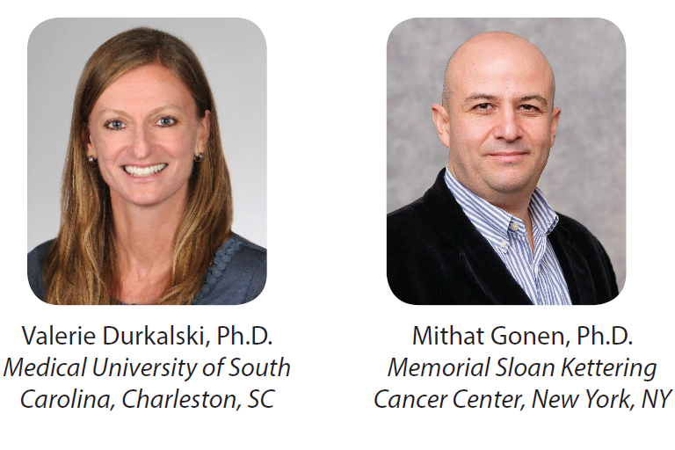
2019 SCT Committee Chairs
(continued)
LEADERSHIP COMMITTEE
Co-Chairs
NEWSLETTER EDITOR
Domenic Reda
Dept. of Veterans Affairs

Slide 24
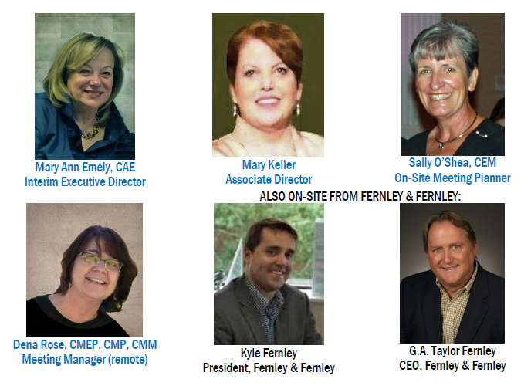
2019 SCT Staff Support in New Orleans
Fernley & Fernley

Slide 25
Election Results

Slide 26
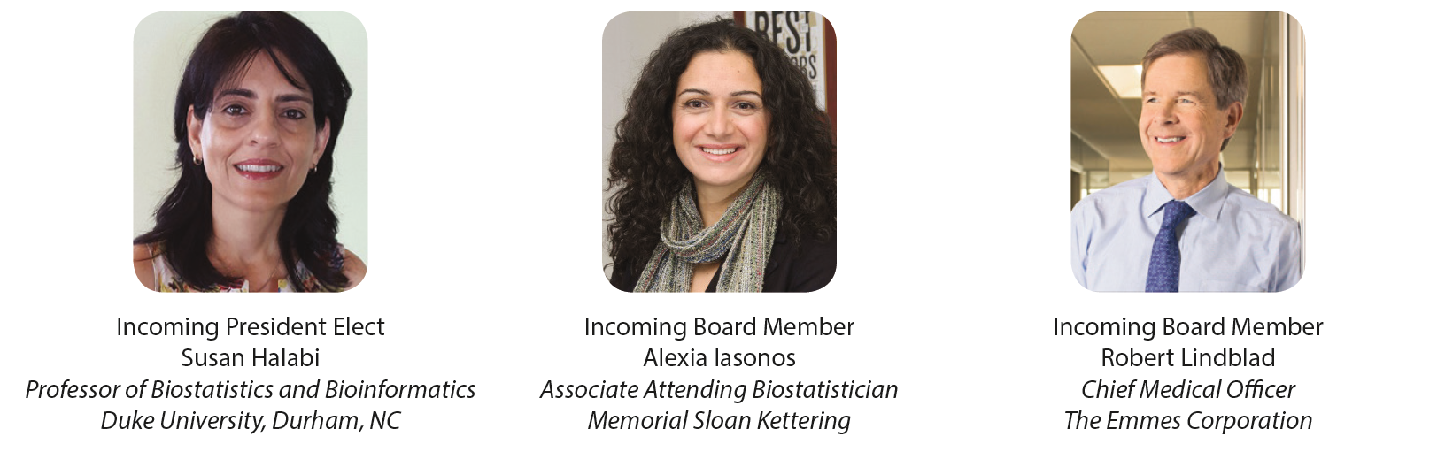
2019-2020 Election Results

Slide 27
Conference Registration Totals
As of May 17, the total number of registered attendees: 582.
Number registered to attend pre-conference workshops: 153.
Number registered to attend in-conference tutorials: 82.
Largest meeting ever!!!

Slide 28
Clinical Trials
Journal Report
Colin B. Begg

Slide 29
Membership Committee Update
Jody Ciolino

Slide 30
Communications Committee Update
Leslie Ain McClure

Slide 31
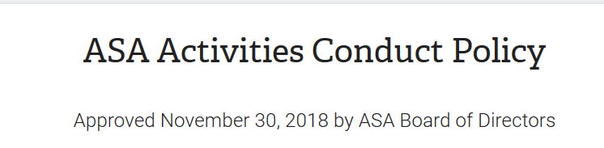

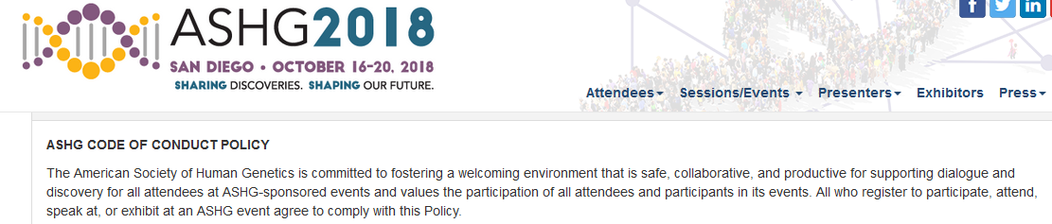
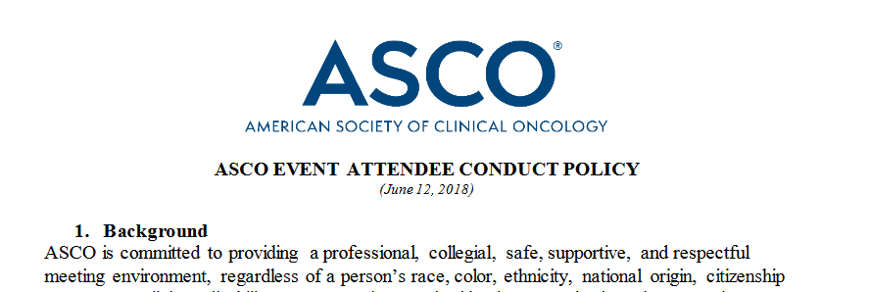
SCT Conduct Policy

Slide 32
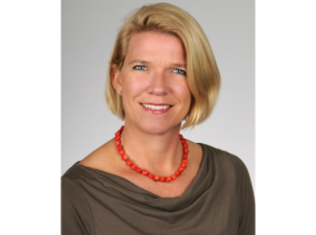
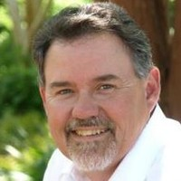
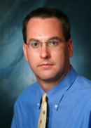
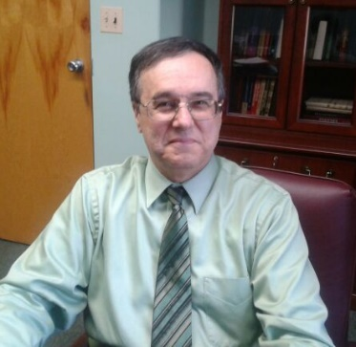
Communications Committee
Elizabeth Garrett-Mayer
Co-Chair
Scott Rushing
Website Chair
Domenic Reda
Newsletter Chair
Chris Coffey
Social Media Chair

Slide 33
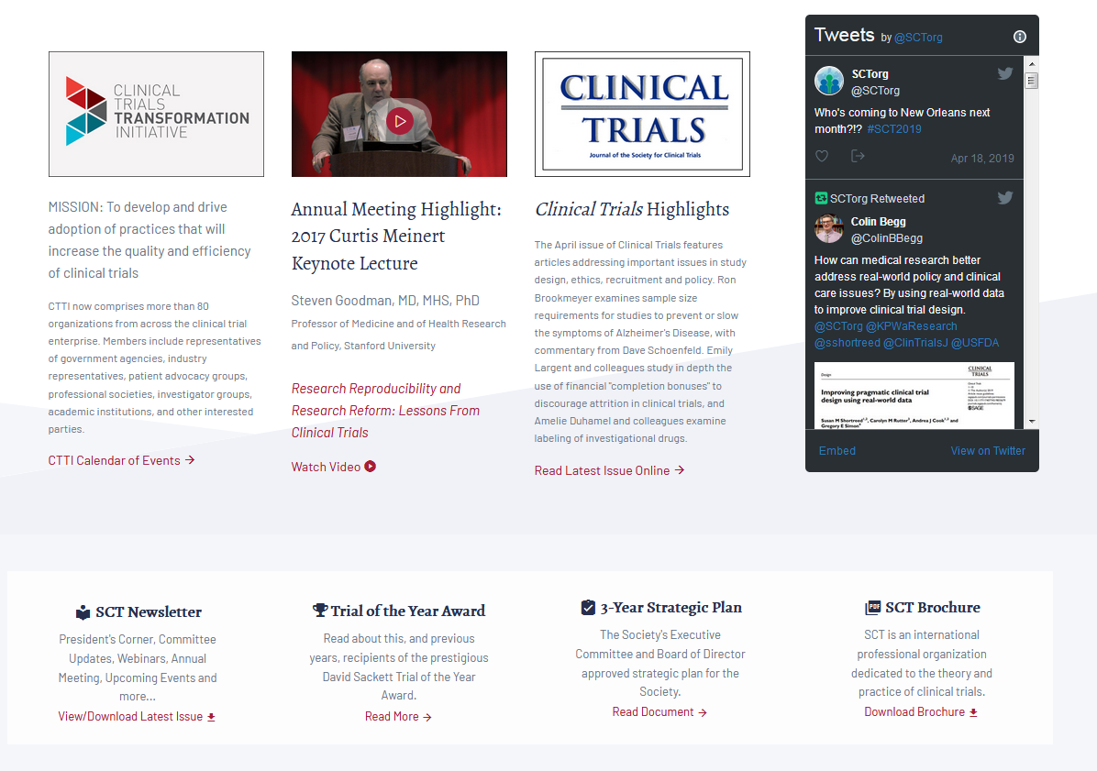
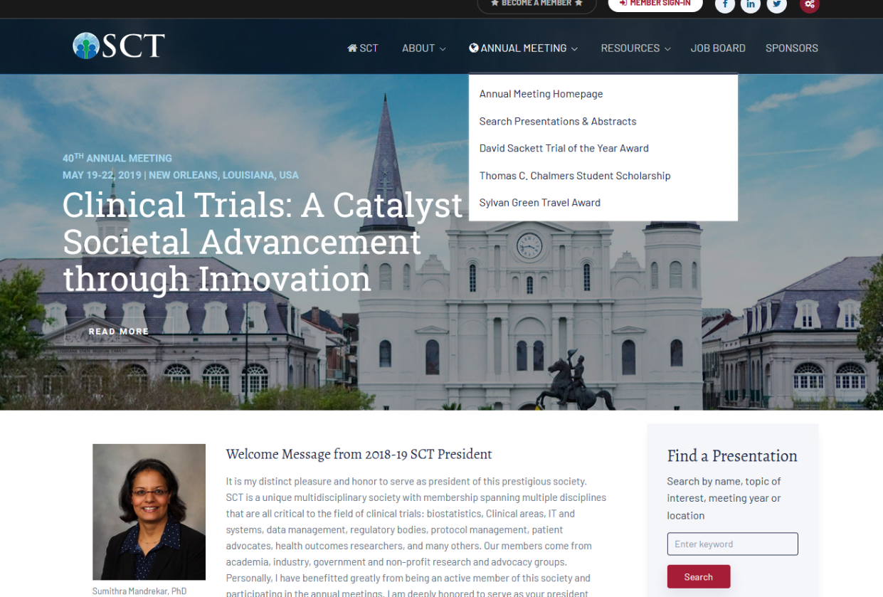
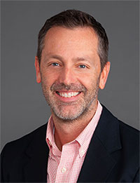
SCT Website
John Hepler
Web Developer

Slide 34
Communications Committee
What we need:
  Volunteers for subcommittees
  Content for the website
  Content for the newsletter

Slide 35
Chalmers Student Scholarship
Jim Dignam

Slide 36
The Dr. Thomas C. Chalmers
Student Scholarship
This Scholarship was named in honor of Dr. Thomas C. Chalmers, who was a founding member of the SCT, served on the Board and was President in 1984.
Dr. Chalmers was a dedicated early advocate of randomized trials, evidence-based medicine, pioneered methods and practices that have become standards today.
Students enrolled in a degree program of an accredited college or university, or post-doctoral fellows are eligible to apply for the scholarship.

Slide 37
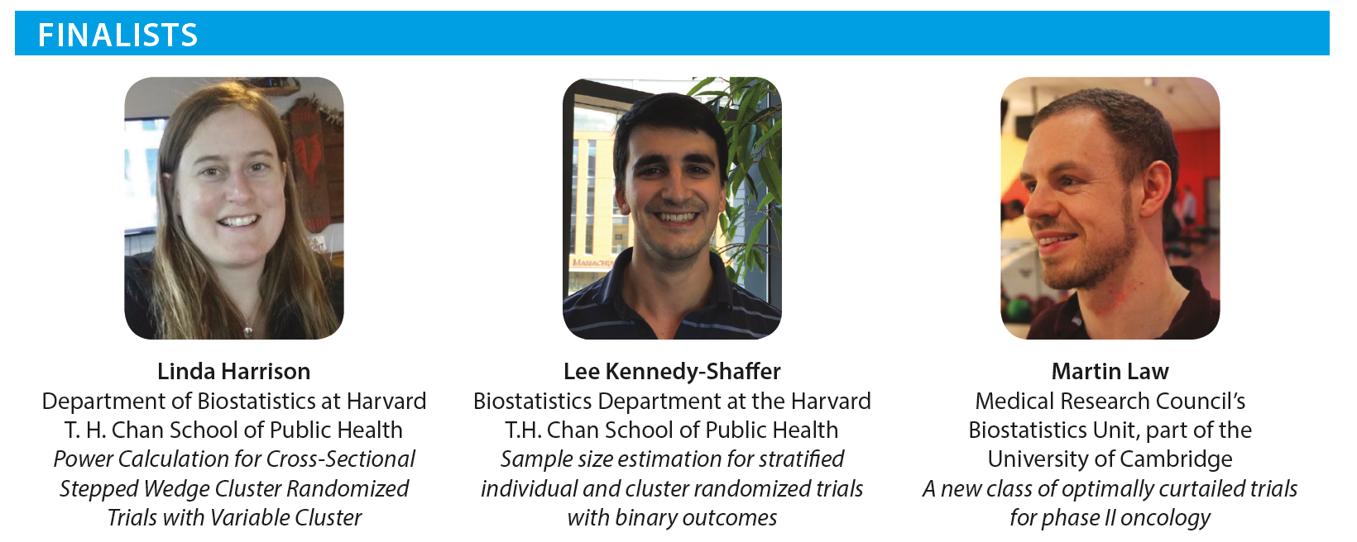
The Dr. Thomas C. Chalmers
Student Scholarship

Slide 38
Sylvan Green Winner
Jim Dignam

Slide 39
The Sylvan Green Winner
This award was created in 2011 to honor Sylvan Green, MD for his service to the Society. He served as President of the Society in 1994, chaired the Education the Student Scholarship Committees and was inducted as a Fellow in 2007.
This award is open to physicians and dentists involved in clinical trials or epidemiology projects.

Slide 40
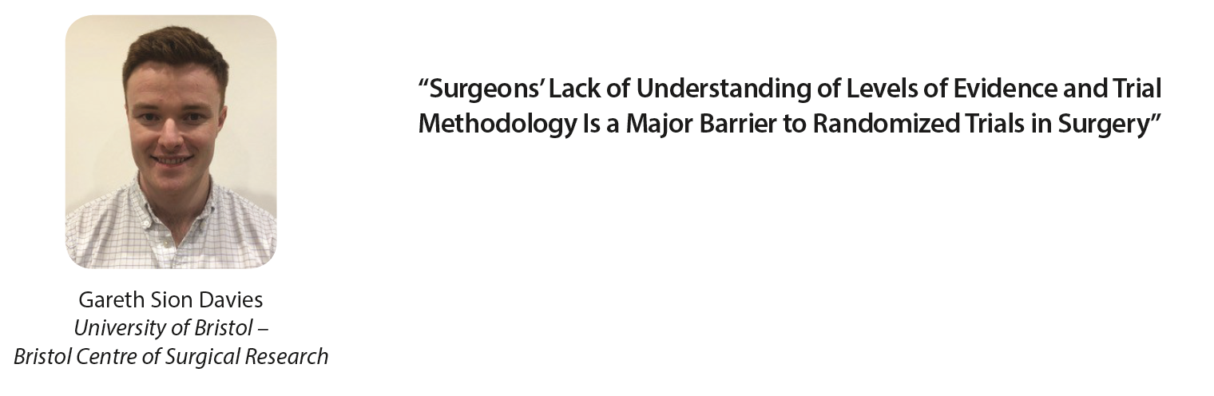
The Sylvan Green Winner

Slide 41
Best Poster Presentation
Tisha Perdue

Slide 42
Remarks from Incoming President
Dean Fergusson
Awards to Outgoing President and Board Members
Future Annual Meetings

Slide 43
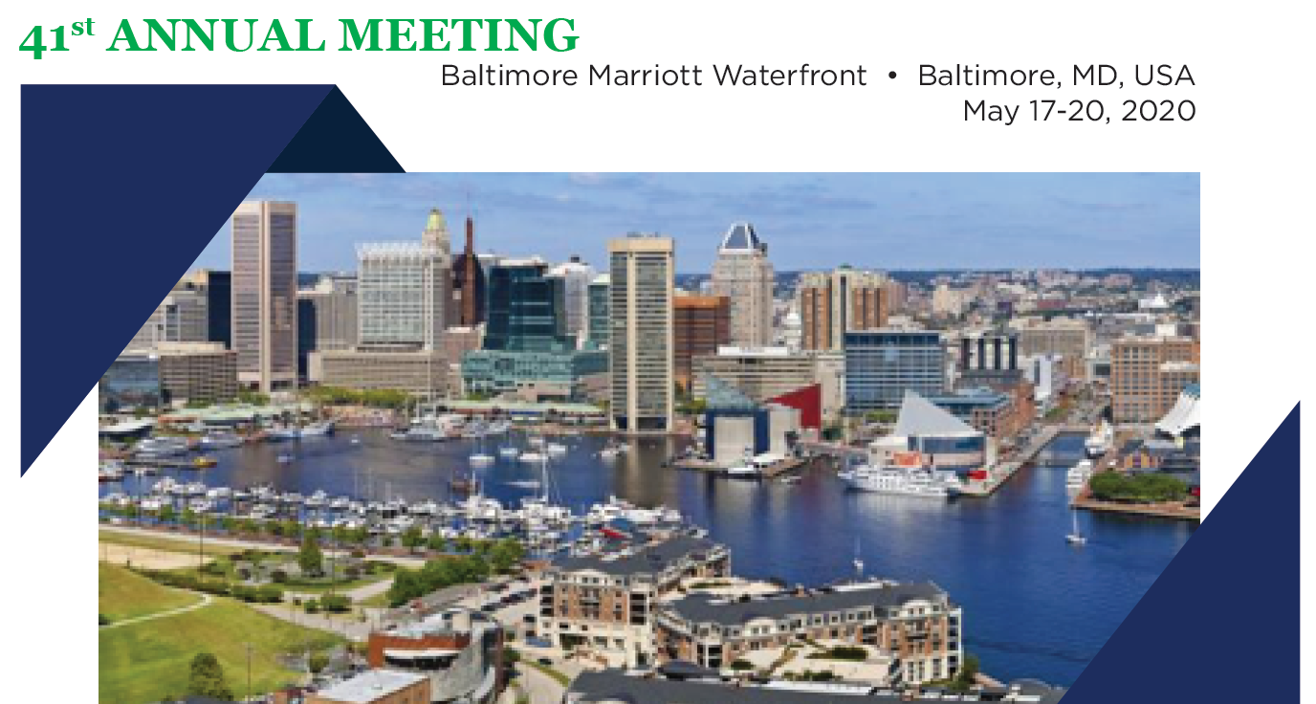
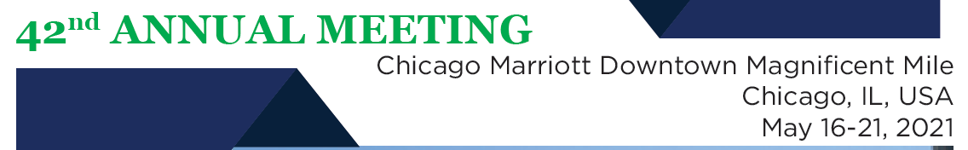
SAVE THE DATE!
Future Meetings

Slide 44
Closing Remarks from President
Sumithra Mandrekar
Open Discussion/Q&A
Adjournment

